Slide 1
ML Probalities & statisticals

Slide 2
Probabilistic Classification Principle
Maximum A Posterior (MAP) classification rule
For an input x, find the largest one from L probabilities output by a discriminative probabilistic classifier
Assign x to label c* if is the largest.
Generative classification with the MAP rule
Apply Bayesian rule to convert them into posterior probabilities
Then apply the MAP rule to assign a label
Common factor for all L probabilities

Slide 3
Naïve Bayes classifier
Bayes classification
Difficulty: learning the joint probability is often infeasible!
Naïve Bayes classification
Assume all input features are class conditionally independent!
Apply the MAP classification rule: assign to c* if
Applying the independence assumption

Slide 4
Advantages of Naive Bayes Algorithm
Easy to implement.
Fast
If the independence assumption holds then it works more efficiently than other algorithms.
It requires less training data.
It is highly scalable.
It can make probabilistic predictions.
Can handle both continuous and discrete data.
Insensitive towards irrelevant features.
It can work easily with missing values.
Easy to update on arrival of new data.
Best suited for text classification problems.

Slide 5
Disadvantages of Naive Bayes Algorithm
The strong assumption about the features to be independent which is hardly true in real life applications.
Data scarcity.
Chances of loss of accuracy.
Zero Frequency i.e. if the category of any categorical variable is not seen in training data set then model assigns a zero probability to that category and then a prediction cannot be made.

Slide 6
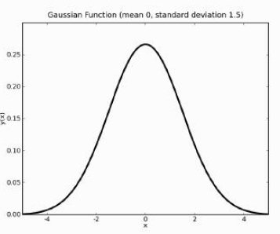

The Gaussian or normal distribution

Slide 7
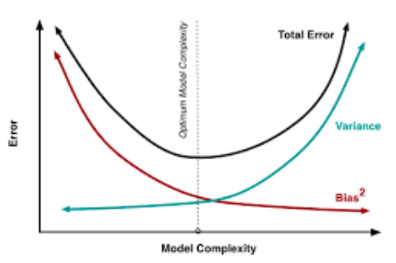
Bias-Variance Trade-off
Bias error is useful to quantify how much on an average are the predicted values different from the actual value
Variance on the other side quantifies how are the prediction made on same observation different from each other

Slide 8
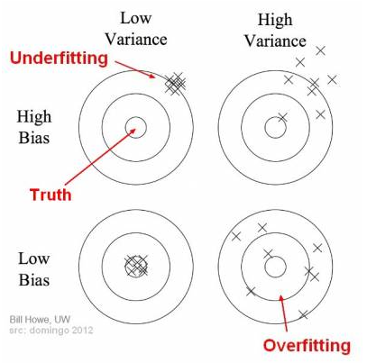
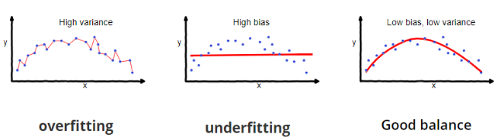
Bias and variance using bulls-eye diagram

Slide 9
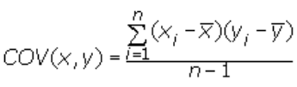
Some basic statistic
Variance is used to measure the spread of given set of numbers and calculated by the average of squared distances from the mean
Covariance is a measure of the joint variability of two random variables. It’s similar to variance, but where variance tells you how a single variable varies, co variance tells you how two variables vary together. The formula for covariance is:
Standard deviation signifies how dispersed is the data. It is the square root of the variance of underlying data. Standard deviation is calculated for a population.

Slide 10


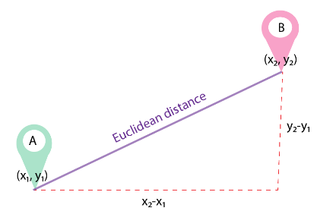
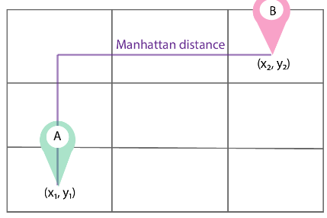
Distance measures
Euclidean distance Manhattan distance

Slide 11

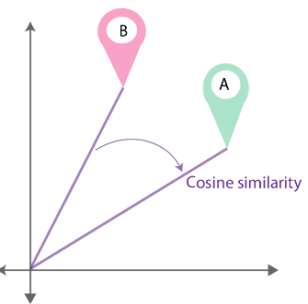

Distance measures
Mahalanobis Distance: When we need to calculate the distance of two points in multivariate space, we need to use the Mahalanobis distance
where Xa and Xb are a pair of objects and C is the sample covariance matrix
Cosine similarity

Slide 12

Distance measures
Jaccard distance
Jaccard similarity = |A ∩ B| / |A ∪ B|
Minkowski distance
the similarity metric between two points in the normed vector space (N-dimensional real space)

